Slide 1

Microprocessor & Microcontroller Laboratory
Project Presentation On
“Obstacle Avoiding System
using Ultrasonic Sensor”
Submitted to
Kingshuk Dhar
Assistant Professor
Department of Computer Science & Engineering.
Submitted By
K.M. Naimuddin
1803510201621
Sajjad Hossain Talukder
1803510201623
Rakibur Rahman
1803510201638

Slide 2

Content
Here is our contents.
Introduction
Equipment’s
Working Procedure
Circuit Design
Simulation Video
Advantages
Applications

Slide 3


Introduction
Some Information about our project.
Obstacle Avoiding System using Ultrasonic Sensor is an intelligent device which can automatically sense the obstacle in front of it and avoid them by turning itself.
It is capable of moving on its own in an unknown and unstructured environment.
This system is equipped with software intelligence to sense its environment, detect obstacles in its path and move around an unknown environment overcoming the obstacles.
Business Presentation

Slide 4
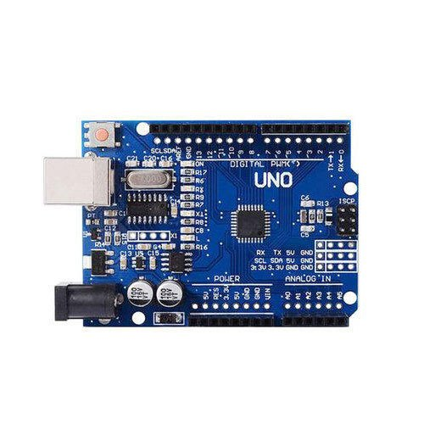
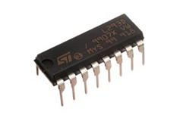
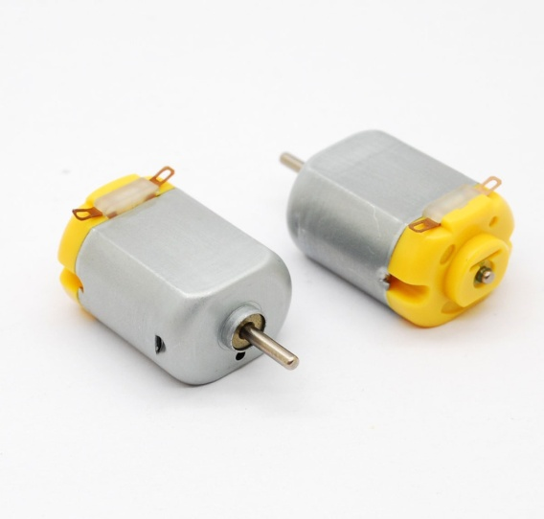
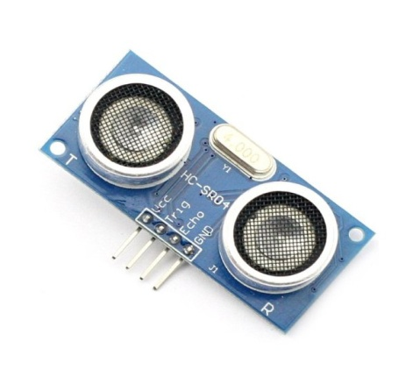
Step two
Equipment’s Name
Subtitle will go here.
Let’s know about equipment’s
Business Presentation
Arduino UNO
H-bridge Motor Driver
Performance Details – Month wise
Text box with bullets
  Text box with bullets
  Text box with bullets
DC Motor
Ultrasonic Distance Sensor

Slide 5
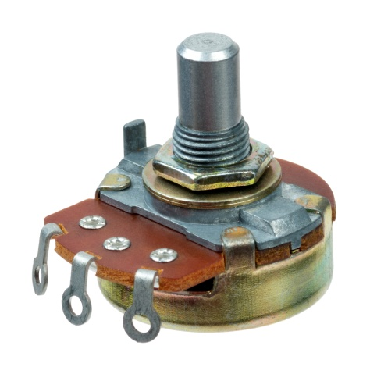
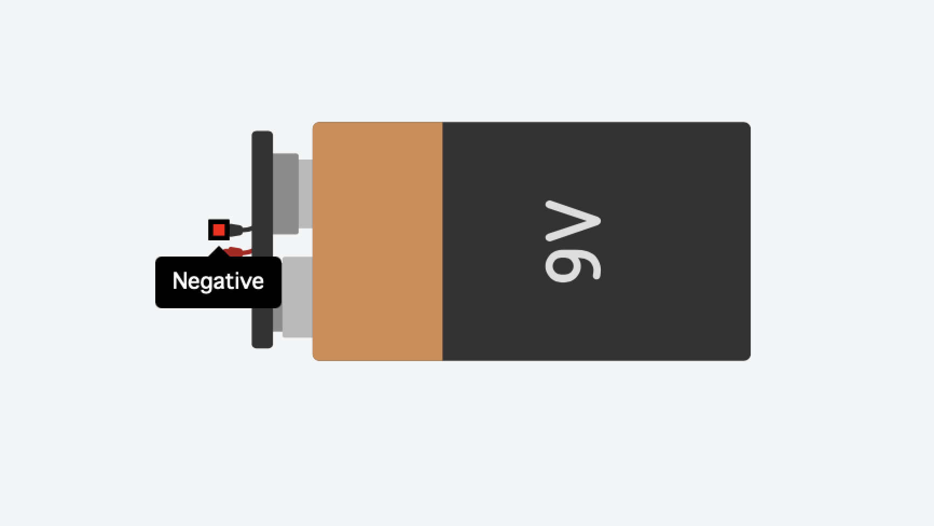
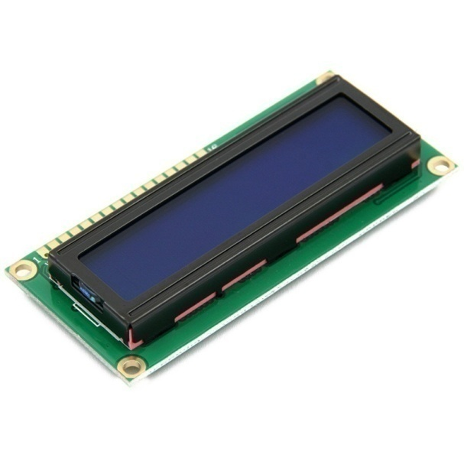
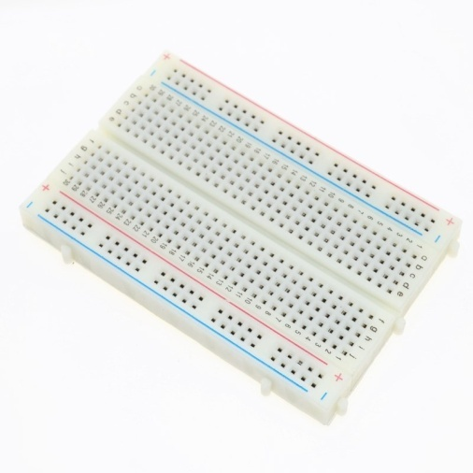
Equipment’s Name
Let’s know about equipment’s
Business Presentation
Potentiometer
9V Battery
Breadboard
LCD 16*2

Slide 6
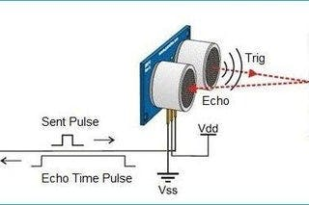
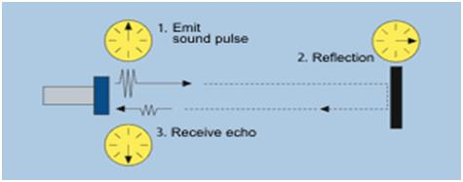
Working Procedure
How does it works?
Business Presentation
Obstacle Avoiding system is an self driven Arduino based system that works using ultrasonic sensor.
Ultrasonic sensor note down the time taken by sensor to transmit ultrasonic beams and receiving the ultrasonic beams after hitting the surface.
Then further the distance is calculated using the formula :
Distance = Duration*0.034/2 ; [ using s = v t
v = velocity of sound
t = total duration ]

Slide 7
Working Procedure
How does it works?
Based on the distance calculated, Arduino sends pulse to H-bridge motor drive.
H-bridge Motor driver controls the rotation of Motors. According to the pulse received from Arduino, it rotates DC Motor either Clockwise or Anti-clockwise or make it off.
if distance is greater than 20
Both motor on – Clockwise
if distance is lesser than or equal to 20
step 01 – Stop Motor
step 02 – Motor on – Anti-Clockwise
step 03 – Stop Motor
step 04 – Move left Motor to turn right
At the same time, 16*2 LCD screen shows the current situation of system on its screen.
Business Presentation

Slide 8
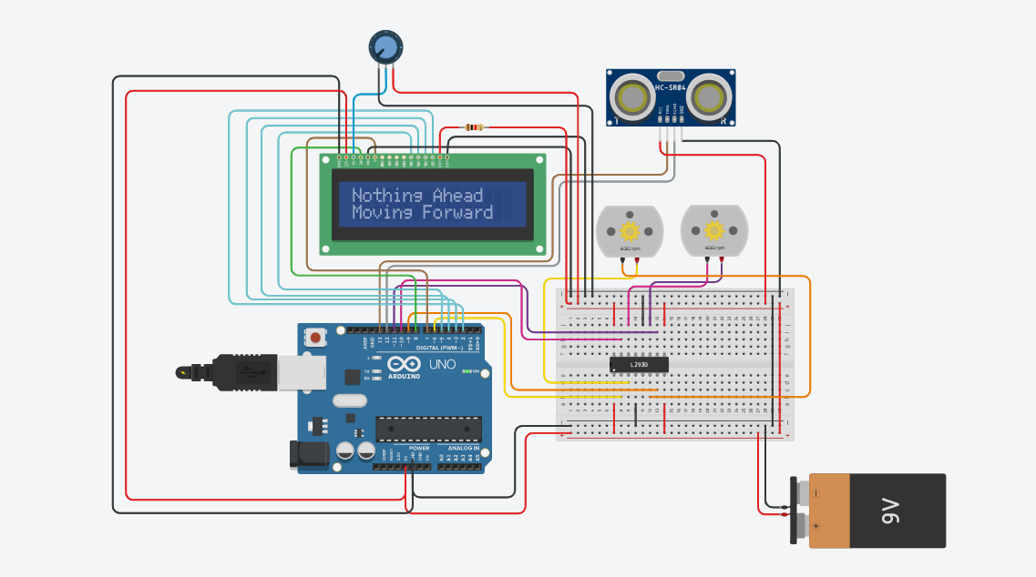
Circuit Design
This is our circuit.
Business Presentation

Slide 9


Slide 10

Advantages
How will we do use this
Ø Collision control.
Ø It provides Safe Navigation.
Ø This is the basic of all robot and has a wide scope of extensions
Ø These system are easy and quick to compute.
Ø These are not affected by the noise in the surrounding.
Ø These can easily detect the object at a distance.
Ø These can easily detect the edges and their respective orientation.

Slide 11
Applications
Where will we do use this
Obstacle avoiding systems can be used in almost all mobile robot navigation systems.
They can be used for household work like automatic vacuum cleaning.
They can also be used in dangerous environments, where human penetration could be fatal.
In the growing need of usage of unmanned aerial vehicles in urban areas for especially military applications where obstacle avoiding systems can be very useful.
As recent advances in the autonomous vehicles sector, a good and dependable obstacle avoidance system of a driverless platform can be very useful.

Slide 12


Thank You For your Patience!

